Slide 1
Chapter 11: normalization & joins
2023

Slide 2
Chapter 11: normalization & joins
Content:
What is normalization
Relationships
Joins
inner join
left join
right join
outer join
full join

Slide 3
What is Normalization?
Database normalization is the process of structuring a relational database in accordance with a series of so-called normal forms in order to reduce data redundancy and improve data integrity.

Slide 4
Normalization
Normalization Avoids
Duplication of Data - The same data is listed in multiple lines of the database
Insert Anomaly -A record about an entity cannot be inserted into the table without first inserting information about another entity
- Cannot enter a customer without a sales order
Delete Anomaly - A record cannot be deleted without deleting a record about a related entity. Cannot delete a sales order without deleting all of the customer s information.
Update Anomaly - Cannot update information without changing information in many places. To update customer information it must be updated for each sales order the customer has placed
Notes:
Delete?

Slide 5
Normalization
First normal form
Eliminate repeating groups in individual tables.
Create a separate table for each set of related data.
Create separate fields for combined parts
Identify each set of related data with a primary key.
Second normal form
Create separate tables for sets of values that apply to multiple records.
Relate these tables with a foreign key.
Third normal form
Eliminate fields that do not depend on the key.

Slide 6
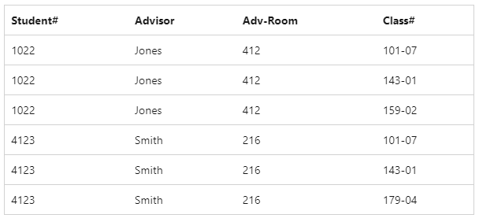
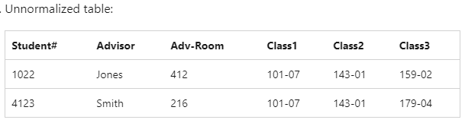
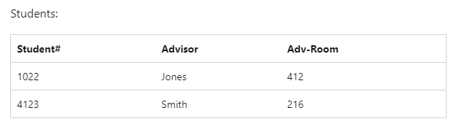
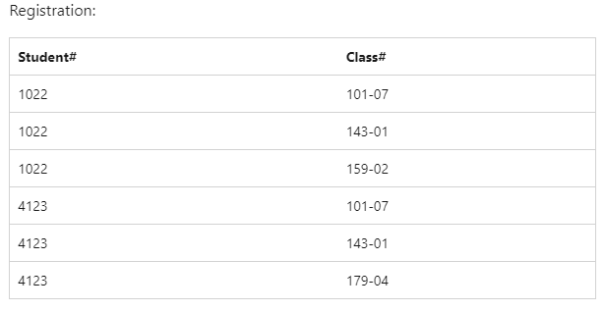
Normalization
Notes:
Step 1: No repeating groups/ Column headings
Step 2:Eliminate redundant data/ Move data to tables where it is more suitable

Slide 7
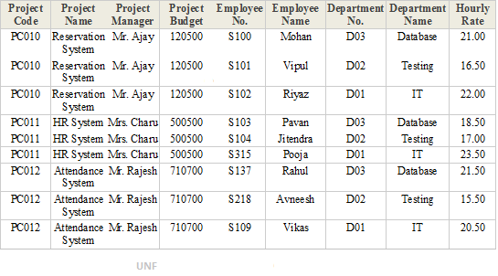
Normalisation
Observe the table below, Explain what normalization process you would apply to it to have a normalized dataset.
Notes:
L&D company db

Slide 8
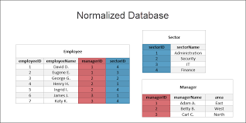
Normalisation
Observe the table below, Explain what normalization process was applied to it to have a normalized dataset.
Notes:
L&D company db

Slide 9
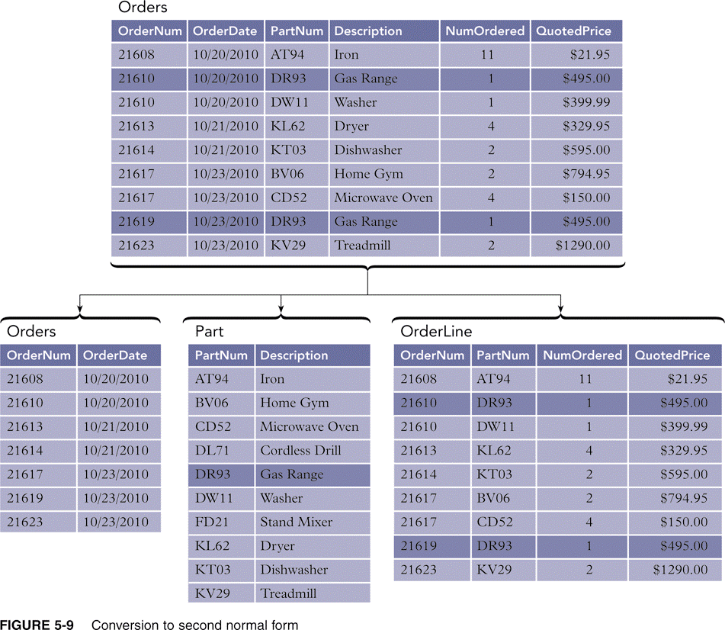
Normalisation
Observe the table below, Explain what normalization process you would apply to it, to have a normalized dataset.
Notes:
L&D company db

Slide 10
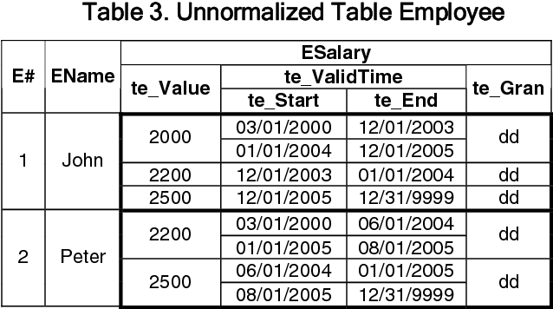
Normalisation
Observe the table below, Explain what normalization process you would apply to it, to have a normalized dataset.
Notes:
L&D company db

Slide 11
Types of relationships
One to One
One to many
Many to Many
Notes:
Explain the meaning and examples of each
1 – many – most common relationship
Customers and orders

Slide 12
One to One
For every record in the first table one and only one record exists in the second table. These are not common in relational databases

Slide 13
One to Many
This is a far more common relationship. Each record in the first table (the parent) is related to one or more records in the second table (the child). Each record in the second table is related to one and only one record in the first table.
Notes:
Examples
1) Customers and orders • Each customer (the “one” side) has placed several orders (the “many” side) but each order is sent to a single customer
2) Teacher and student • Each teacher has many students but each student has a single teacher (within a particular class)
3) Employees and paychecks • Each employee has received several paychecks but each paycheck is given to one and only one employee

Slide 14
Many to Many
In a many to many arrangements each record in both tables can be related to zero one or many records in the other table.
The many to many relationships is broken into
In order to create a many to many relationships the join table must contain the primary keys of both tables joined by the relationship.
Notes:
1-For example each student in tblStudents can belong to more than one club while each club in tblClubs has more than one member.
2-separate one to many relationships joined through a linking table (called a join table). The join table has one to many relationships with both of the tables involved in the many to many relationships.
Examples:
Many to many relationships are quite common in business environments. Examples include:
1) Lawyers to clients (or doctors to patients): Each lawyer may be involved in several cases while each client may be represented by more than one lawyer on each case
2) Video rentals and customers: Over a year s time each video is rented by several people while each customer rents more than one video during the year
3) Magazine subscriptions: Most magazines have circulations measured in the thousands or millions. Most people subscribe to more than one magazine at a time

Slide 15
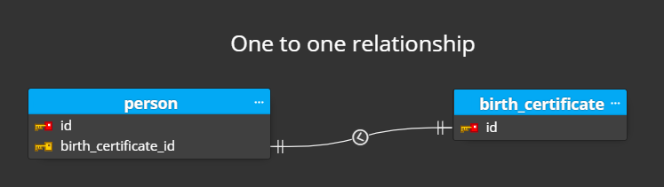
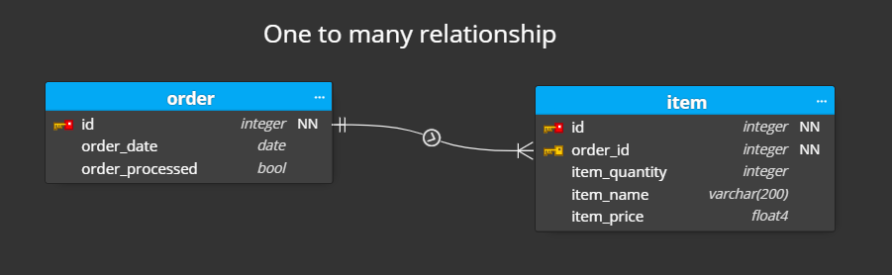
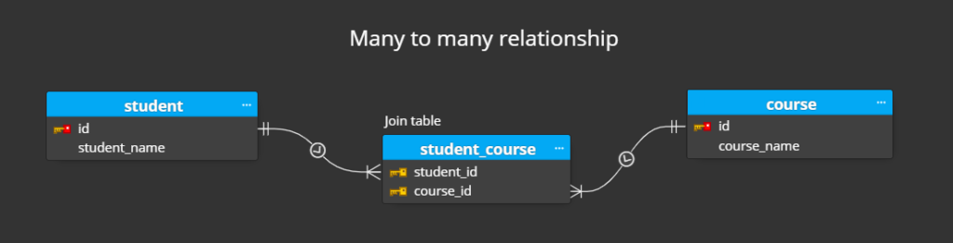
Relationships examples
Notes:
Examples:
Many to many relationships are quite common in business environments. Examples include:
1) Lawyers to clients (or doctors to patients): Each lawyer may be involved in several cases while each client may be represented by more than one lawyer on each case
2) Video rentals and customers: Over a year s time each video is rented by several people while each customer rents more than one video during the year
3) Magazine subscriptions: Most magazines have circulations measured in the thousands or millions. Most people subscribe to more than one magazine at a time

Slide 16


Slide 17
Different Types of SQL JOINs
(INNER) JOIN:
Returns records that have matching values in both tables
LEFT (OUTER) JOIN:
Returns all records from the left table and the matched records from the right table
RIGHT (OUTER) JOIN:
Returns all records from the right table and the matched records from the left table
FULL (OUTER) JOIN:
Returns all records when there is a match in either left or right table
Notes:
You also get Cartesian join to join everything from table A to everything from table B
(The CARTESIAN JOIN is also known as CROSS JOIN. In a CARTESIAN JOIN there is a join for each row of one table to every row of another table. This usually happens when the matching column or WHERE condition is not specified.)
Join every student with every class [at school])
Inner Join – You also get a natural join where the linking column has the same name in both tables

Slide 18
Joins
SELECT Orders.OrderID, Customers.CustomerName, Orders.OrderDate FROM Orders INNER JOIN Customers
ON Orders.CustomerID=Customers.CustomerID;
Notes:
A JOIN clause is used to combine rows from two or more tables based on a related column between them.

Slide 19
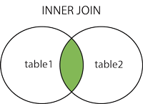
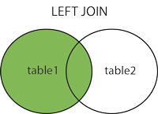
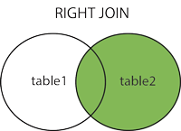
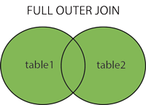

Slide 20
Inner Join
The INNER JOIN keyword selects all rows from both the tables as long as the condition satisfied.
This keyword will create the result-set by combining all rows from both the tables where the condition satisfies i.e value of the common field will be same.
table1: First table.
table2: Second table
matching column: Column common to both the tables.
Note: We can also write JOIN instead of INNER JOIN. JOIN is same as INNER JOIN.

Slide 21
Inner Join
SELECT column_name(s) FROM table1 INNER JOIN table2 ON table1.column_name = table2.column_name;
SELECT Orders.OrderID, Customers.CustomerName FROM Orders INNER JOIN Customers ON Orders.CustomerID = Customers.CustomerID;
Notes:
The INNER JOIN keyword selects records that have matching values in both tables.
SELECT Employees.EmployeeID Employees.FirstName
Employees.LastName Orders.OrderID Orders.OrderDate
FROM Employees JOIN Orders ON
(Employees.EmployeeID = Orders.EmployeeID)
ORDER BY Orders.OrderDate;

Slide 22
Full Outer Join
FULL JOIN creates the result-set by combining result of both LEFT JOIN and RIGHT JOIN. The result-set will contain all the rows from both the tables. The rows for which there is no matching the result-set will contain NULL values.
table1: First table.
table2: Second table
matching_column: Column common to both the tables.
Notes:
SELECT table1.column1 table1.column2 table2.column1 ....
FROM table1
FULL JOIN table2
ON table1.matching_column = table2.matching_column;

Slide 23
Full Outer Join
SELECT column_name(s) FROM table1 FULL OUTER JOIN table2 ON table1.column_name = table2.column_name WHERE condition;
SELECT Customers.CustomerName, Orders.OrderID FROM Customers FULL OUTER JOIN Orders ON Customers.CustomerID=Orders.CustomerID ORDER BY Customers.CustomerName;
Notes:
MySQL does not support FULL JOIN so you have to combine JOIN UNION and LEFT JOIN to get an equivalent. It gives the results of A union B. It returns all records from both tables. Those columns which exist in only one table will contain NULL in the opposite table. (see at the end)
The FULL OUTER JOIN keyword returns all records when there is a match in left (table1) or right (table2) table records.
Note: FULL OUTER JOIN can potentially return very large result-sets!
Tip: FULL OUTER JOIN and FULL JOIN are the same.
SELECT COUNT(DISTINCT e.EmployeeID) AS numEmployees
COUNT(DISTINCT c.CustomerID) AS numCompanies
e.City c.City
FROM Employees e FULL JOIN Customers c ON
(e.City = c.City)
GROUP BY e.City c.City
ORDER BY numEmployees DESC;
Alternative to Full join in mysql:
SELECT * FROM a
LEFT JOIN b
ON a.id = b.id
UNION
SELECT * FROM a
RIGHT JOIN b
ON a.id = b.id

Slide 24
Left Join
This join returns all the rows of the table on the left side of the join and matching rows for the table on the right side of join. The rows for which there is no matching row on right side the result-set will contain null. LEFT JOIN is also known as LEFT OUTER JOIN.
table1: First table.
table2: Second table
matching_column: Column common to both the tables.
We can also use LEFT OUTER JOIN instead of LEFT JOIN both are same.
Notes:
SELECT table1.column1 table1.column2 table2.column1 ....
FROM table1
LEFT JOIN table2
ON table1.matching_column = table2.matching_column;

Slide 25
Left Join
SELECT column_name(s) FROM table1 LEFT JOIN table2 ON table1.column_name = table2.column_name;
SELECT Customers.CustomerName, Orders.OrderID FROM Customers LEFT JOIN Orders ON Customers.CustomerID = Orders.CustomerID ORDER BY Customers.CustomerName;
Notes:
The LEFT JOIN keyword returns all records from the left table (table1) and the matched records from the right table (table2). The result is NULL from the right side if there is no match.
SELECT COUNT(DISTINCT e.EmployeeID) AS numEmployees
COUNT(DISTINCT c.CustomerID) AS numCompanies
e.City c.City
FROM Employees e LEFT JOIN Customers c ON
(e.City = c.City)
GROUP BY e.City c.City
ORDER BY numEmployees DESC;

Slide 26
Right Join
RIGHT JOIN is similar to LEFT JOIN. This join returns all the rows of the table on the right side of the join and matching rows for the table on the left side of join. The rows for which there is no matching row on left side the result-set will contain null. RIGHT JOIN is also known as RIGHT OUTER JOIN.
table1: First table.
table2: Second table
matching_column: Column common to both the tables.
Note: We can also use RIGHT OUTER JOIN instead of RIGHT JOIN both are same
Notes:
JOIN.Syntax:
SELECT table1.column1 table1.column2 table2.column1 ....
FROM table1
RIGHT JOIN table2
ON table1.matching_column = table2.matching_column;

Slide 27
Right Join
SELECT column_name(s) FROM table1 RIGHT JOIN table2 ON table1.column_name = table2.column_name;
SELECT Orders.OrderID, Employees.LastName Employees.FirstName FROM Orders RIGHT JOIN Employees ON Orders.EmployeeID = Employees.EmployeeID ORDER BY Orders.OrderID;
Notes:
The RIGHT JOIN keyword returns all records from the right table (table2) and the matched records from the left table (table1). The result is NULL from the left side when there is no match.
SELECT COUNT(DISTINCT e.EmployeeID) AS numEmployees
COUNT(DISTINCT c.CustomerID) AS numCompanies
e.City c.City
FROM Employees e RIGHT JOIN Customers c ON
(e.City = c.City)
GROUP BY e.City c.City
ORDER BY numEmployees DESC;

Slide 28
Self Join
SELECT column_name(s) FROM table1 T1 table1 T2 WHERE condition;
SELECT A.CustomerName AS CustomerName1 , B.CustomerName AS CustomerName2, A.City FROM Customers A , Customers B WHERE A.CustomerID <> B.CustomerID AND A.City = B.City ORDER BY A.City;
SELECT A.CustomerName AS CustomerName1 , B.CustomerName AS CustomerName2, A.City FROM Customers A
Left join customers B
On a.customerID = b.customerID
Notes:
Select
e.Fname as ”Employer”
m.Fname as “Manager”
From
Employees e
Join
Employees m
On e.ManagerID = m.ID

Slide 29
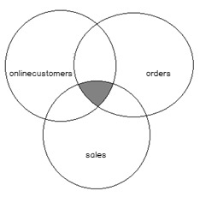
Multiple joins
SELECT customerName customercity customermail salestotal
FROM onlinecustomers AS oc
INNER JOIN
orders AS o
ON oc.customerid = o.customerid
INNER JOIN
sales AS s
ON o.orderId = s.orderId
Notes:
The SQL multiple joins approach will help us to join onlinecustomers orders and sales tables. As shown in the Venn diagram we need to matched rows of all tables. For this reason we will combine all tables with an inner join clause. The following query will return a result set that is desired from us and will answer the question:
Multi-table joins can get very complex and may also take a long time to process but the syntax is relatively straightforward
Syntax
SELECT table1.column table2.column table3.column
FROM table1
JOIN table2 ON (table1.column=table2.column)
JOIN table3 ON (table2.column=table3.column)
WHERE conditions
SELECT o.OrderID c.CompanyName e.FirstName e.LastName
FROM Orders o
JOIN Employees e ON (e.EmployeeID = o.EmployeeID)
JOIN Customers c ON (c.CustomerID = o.CustomerID)
WHERE o.ShippedDate > o.RequiredDate AND o.OrderDate > 1998-01-01
ORDER BY c.CompanyName;

Slide 30
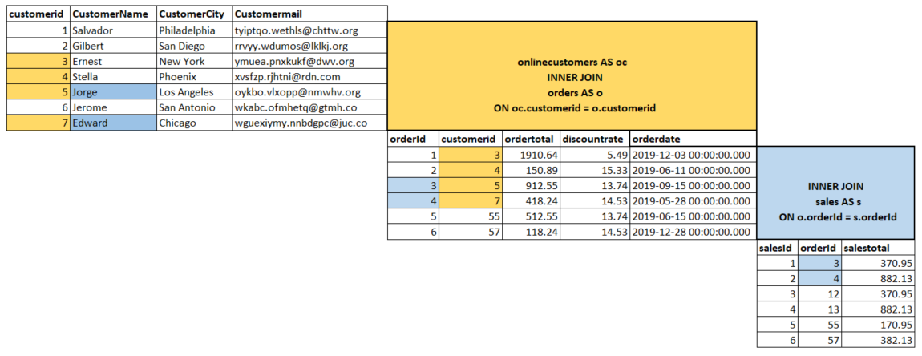
Multiple joins
Notes:
At first we will analyze the query. An inner join clause that is between onlinecustomers and orders tables derived the matched rows between these two tables. The second inner join clause that combines the sales table derived the matched rows from the previous result set. The following colored tables illustration will help us to understand the joined tables data matching in the query. The yellow-colored rows specify matched data between onlinecustomers and orders. On the other hand only the blue colored rows exist in the sales tables so the query result will be blue colored rows:

Slide 31
Joins
Employee
Country
Dependant
Region
Department
Jobs
Location

Slide 32
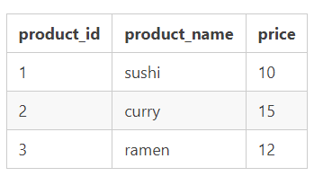
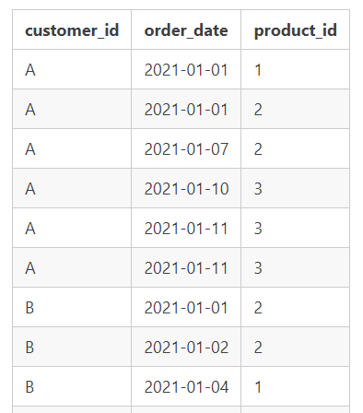
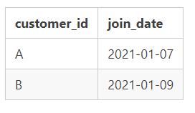
Joins – Restaurant
Sales
Menu
How much money did each member spend at the restaurant?
What is the most purchased item on the menu and how many times was it purchased by all customers?
What is the total items and amount spent for each member before they became a member? **
Members
Notes:
You can send them the next slide – they can the code on the next slide to get this data in SQL – use Insert
1 - select s.customer_ID sum(m.price)from sales s
join menu m on
s.product_id = m.product_id
group by s.customer_id;
2 - select m.product_name count(s.product_ID) as Times_Purchased from menu m
join sales s on
m.product_id = s.product_id
group by m.product_name
order by count(s.product_ID) desc;
3 - select s.customer_ID sum(m.price) from sales s
join menu m on
s.product_id = m.product_id
join members mem on s.customer_id = mem.customer_id
where s.order_date < mem.join_date
group by s.customer_id;

Slide 33
Joins - restaurant
CREATE TABLE menu (
"product_id" INTEGER
"product_name" VARCHAR(5)
"price" INTEGER
);
INSERT INTO menu
("product_id" "product_name" "price")
VALUES
( 1 sushi 10 )
( 2 curry 15 )
( 3 ramen 12 );
CREATE TABLE members (
"customer_id" VARCHAR(1)
"join_date" DATE
);
INSERT INTO members
("customer_id" "join_date")
VALUES
( A 2021-01-07 )
( B 2021-01-09 );
CREATE SCHEMA restaurant;
USE restaurant;
CREATE TABLE sales (
"customer_id" VARCHAR(1)
"order_date" DATE
"product_id" INTEGER
);
INSERT INTO sales
("customer_id" "order_date" "product_id")
VALUES
( A 2021-01-01 1 )
( A 2021-01-01 2 )
( A 2021-01-07 2 )
( A 2021-01-10 3 )
( A 2021-01-11 3 )
( A 2021-01-11 3 )
( B 2021-01-01 2 )
( B 2021-01-02 2 )
( B 2021-01-04 1 )
( B 2021-01-11 1 )
( B 2021-01-16 3 )
( B 2021-02-01 3 )
( C 2021-01-01 3 )
( C 2021-01-01 3 )
( C 2021-01-07 3 );
Notes:
MySQL – remove only from column header values
SQL server – Remove create schema line and just do that part manually

Slide 34
Joins
Display each employee’s first and last name, as well as the job titles to which they belong.
Now include the department titles of each employee in the same results.
Display each employee’s first and last name as well as the department and department’s city where is located.
Determine which employees are managers on the employees table show the full name of the employee and the Manger s first name.
Show all the employees that work in the same department and they order by their department.
What is the total salary paid to each department?
L&D
Notes:
1.select a.first_name,a.last_name,b.job_title from Employees a
inner join jobs b on
a.job_id=b.job_id
2. select a.first_name,a.last_name,b.job_title,c.department_name from Employees a
inner join jobs b on
a.job_id=b.job_id
inner join Departments c on
a.department_id=c.department_id
3. select a.first_name,a.last_name,b.department_name,c.city from Employees a
inner join departments b on
a.department_id=b.department_id
inner join locations c on
c.location_id=b.location_id
4. select a.first_name,a.last_name,b.first_name from Employees a
left join Employees b on
b.employee_id=a.manager_id
5. select a.first_name,a.last_name,b.department_name from Employees a
inner join departments b on
a.department_id=b.department_id
order by b.department_name
6. select a.department_name, sum(b.salary) from Employees b
inner join departments a on
a.department_id=b.department_id
group by a.department_name

Slide 35
***
Show the name, and surname of each employee, together with how many children they have
Show the firstname, their salary amount, and the difference between their salary and the min_amount for their position – thus, how much are they getting more than the minimum amount for that role?
How many employees are based in each region?
L&D
Notes:
select a.first_name,a.last_name,count( b.relationship) from Employees a
left join dependants b on
a.employee_id=b.employee_id
group by a.first_name,a.last_name

